Slide 1

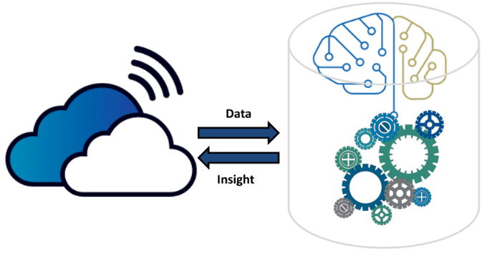


Architecture Diagram
Login
User management
Admin
View Fund Request
View Flagged Request
View Donor Responses
Trusted Database
Medical Fund Fraud Detector Web App
Notification
Notification
Receive Donation
Extract Upload Files Documents
Donate Payment
Approve/Block Req
Preprocessing
View Genuine Req.
Upload Documents
Text Region Detection
Login
Post Fund Request
Text Recognition
Register
Donor
Fund Requester
Login
Pattern Matching
Register
Fund Request Verification
AI Driven Fraud Detector

Slide 2
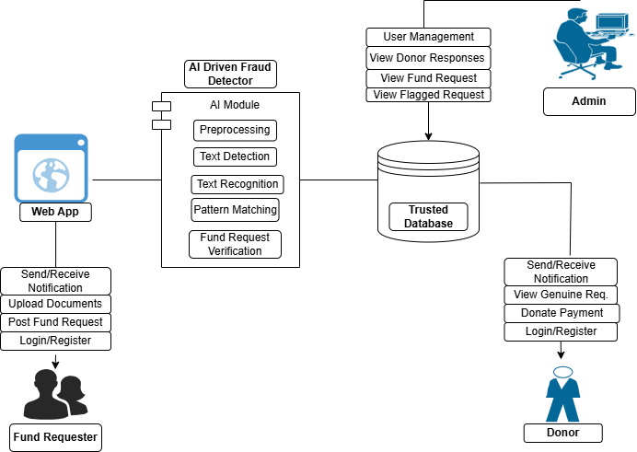
Architecture Diagram

Slide 3
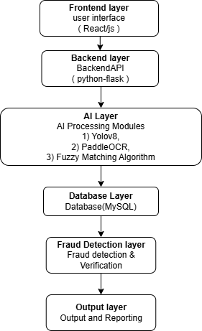
Flow Diagram

Slide 4
Architecture Diagram
Trusted Database
Medical Fund Fraud Detector Web App
Notification
Receive Donation
Extract Upload Files Documents
Notification
Donate Payment
Approve/Block Req
Preprocessing
View Genuine Req.
Upload Documents
Text Region Detection
Login
Post Fund Request
Text Recognition
Register
Donor
Fund Requester
Login
Pattern Matching
Register
Fund Request Verification
AI Driven Fraud Detector

